Slide 1
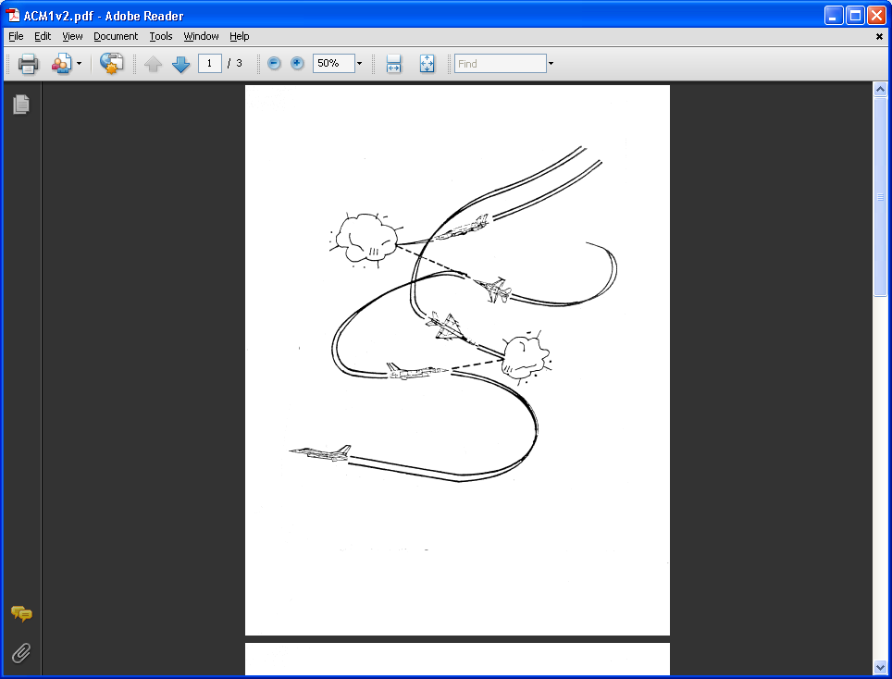
AE 317 Flight Mechanics and Performance
Power Available, Power Required, and Effects
LECTURE 13
Dr. Jeff Ashworth
Aerospace Engineering Department

Slide 2
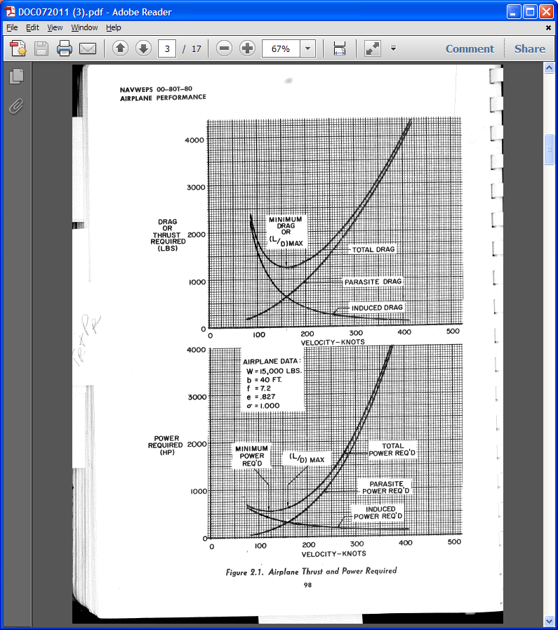
(ANA)

Slide 3
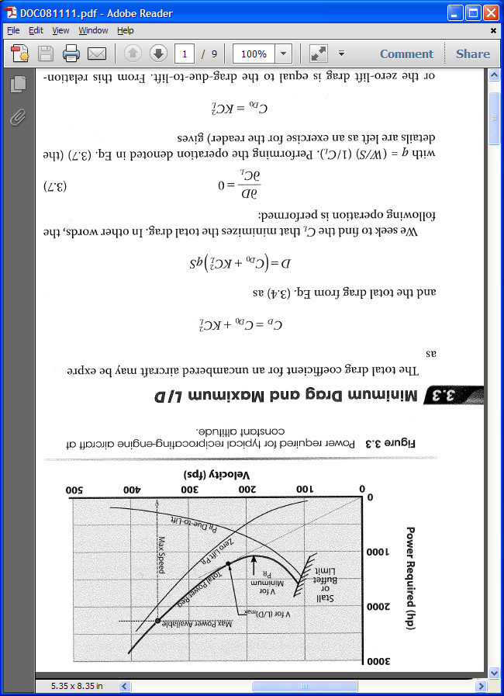
(Nicolai/Carichner)

Slide 4
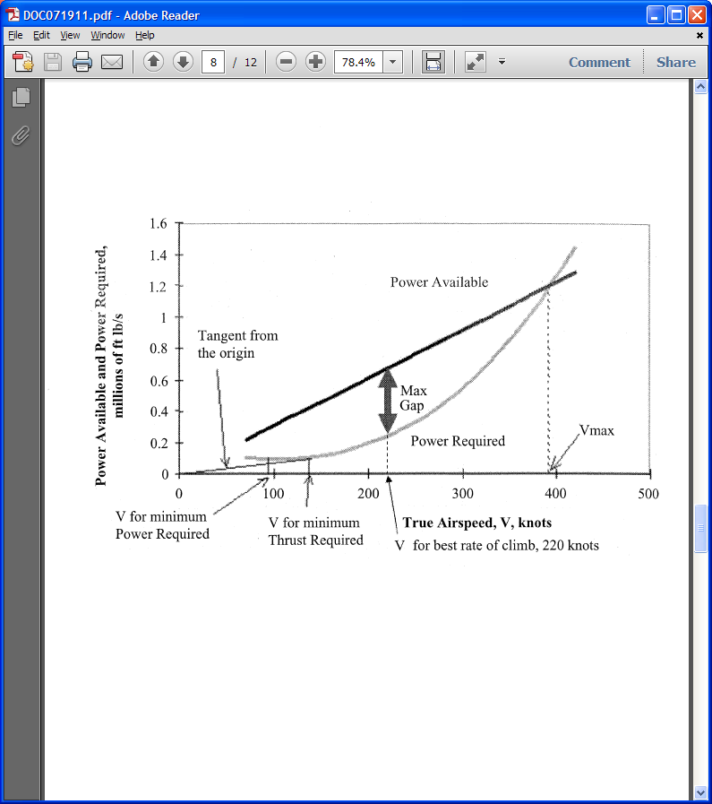
(Brandt)

Slide 5
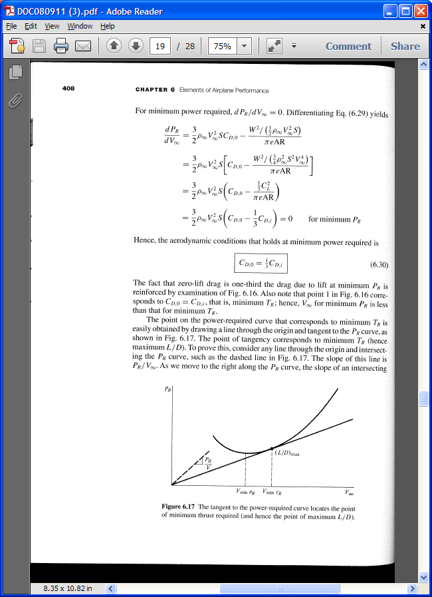
(Anderson)

Slide 6
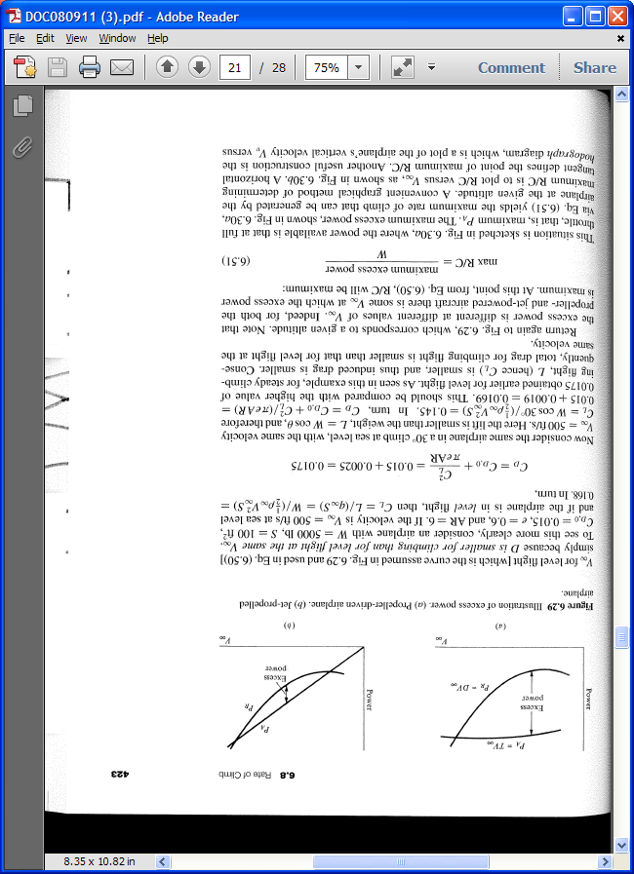
Propeller Jet
(Anderson)

Slide 7
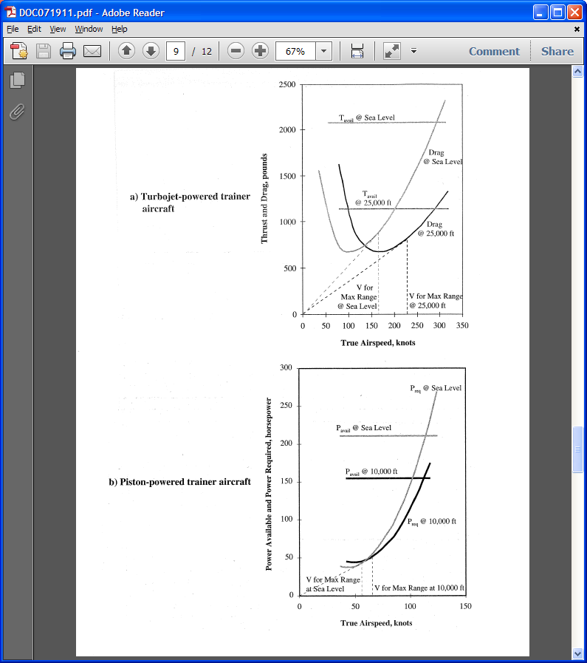
(Brandt)

Slide 8
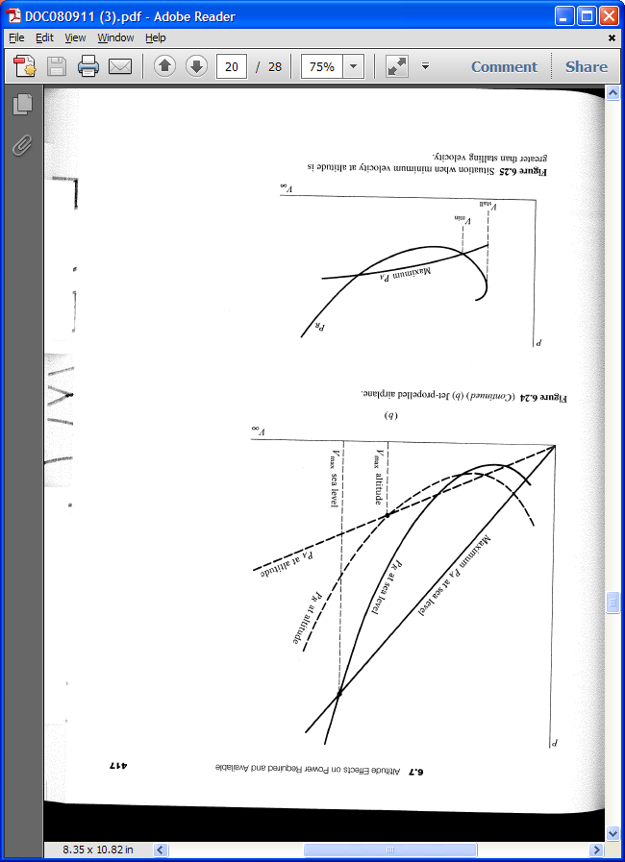
(Anderson)

Slide 9
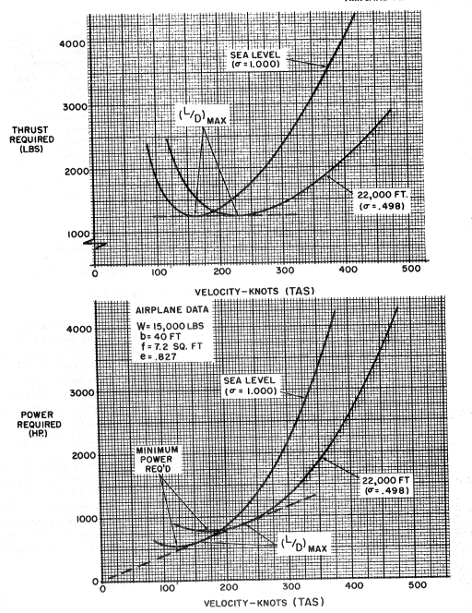
(ANA)

Slide 10
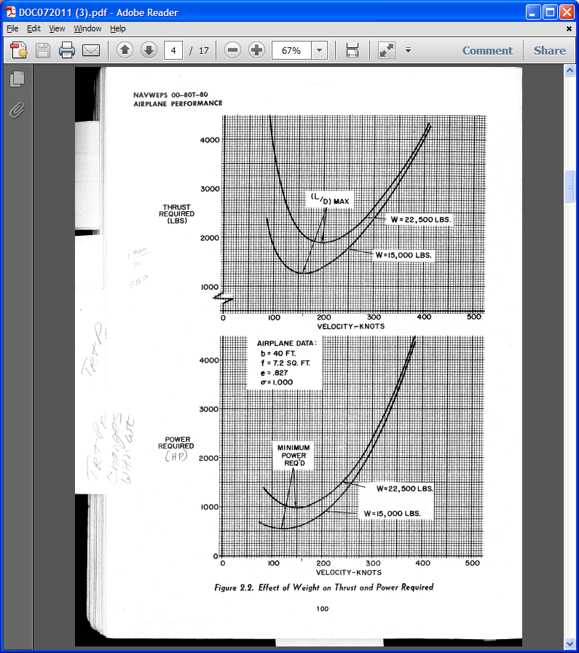
(ANA)

Slide 11
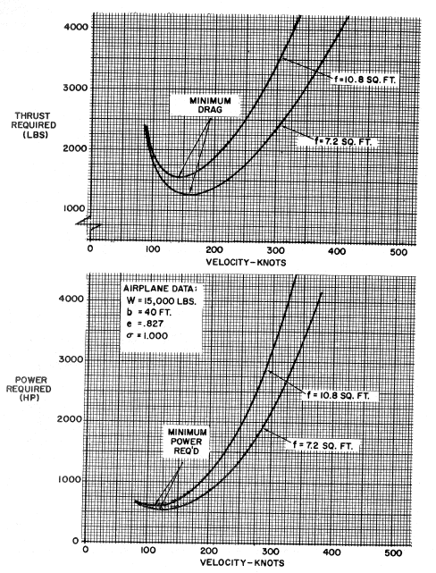
(ANA)

